Slide 1
“The success vision”
Presanted By
Manil shah (85)
Smit trivedi (75)
Anand gami (22)
Mayank hirpara(27)
Sagar patel(88)

Slide 2
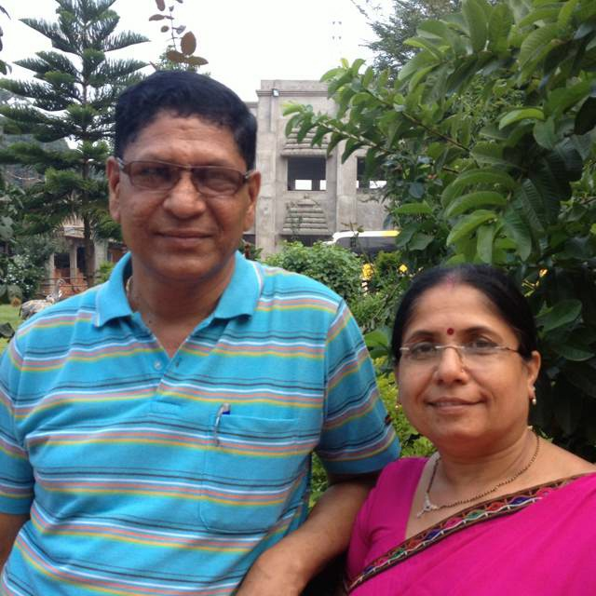
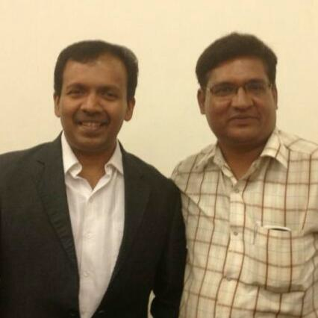
The begniging of leaders

Slide 3
The qualitys of leadership
A leader who alyways ready to motivate
A leader has always creative ideas
A leader should always be cheerful
A leader has power to controll his/her team
A leader should never show his/her attitude

Slide 4
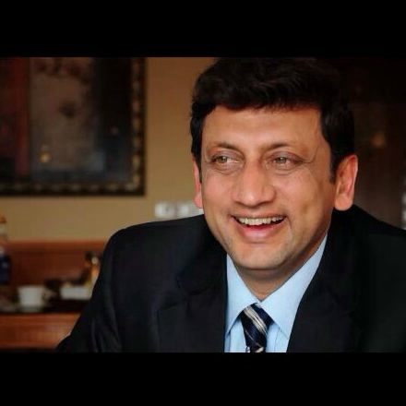
Mr. sp bharil
Mr sp bharil is one of the person who is leading a M.L.M
Type compny (ayushante).
He is a great motivational leader.

Slide 5
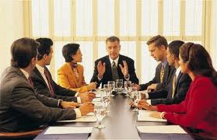

Slide 6
Qualities on the screen
The best leadership of two bollywood stars
This is the best leadership to give knowladge
A leader who alwas ready to shar his/her knowdlage
A leader should able to speak in any where & any time

Slide 7
Qualities on the live stage show
The main thing of A leadership is that a leader who always ready to forward his/her lage first
His /her has never fear to start any type of work yet its hard or easy
There is no age limitation to show your leadership skill

Slide 9
Every leader has his own personality
If the person who know his responsibility then he can become a good leader.
If the person who know his own ability , he can also
become a good leader.
He/She always ready to lead their step.

Slide 10
The way motivational “picture”
In 2004 SP BHARIL (world’s best motivator) said that
“A human is always want some different and unique things
Whitch only can get from pictures.
“perfect picture is the power of peaceful life”

Slide 11
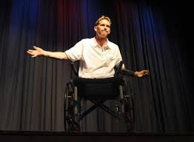
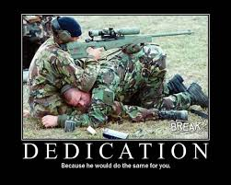
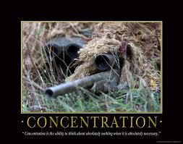
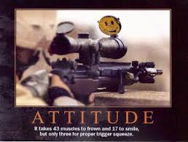
The way of motivational “picture”

Slide 12
Thank you.

