Slide 1
EMBARKING ON THE JOURNEY
TO CONTRIBUTORSHIP

Slide 2
PROJECT GOAL
To study about how people (contributor) embarking on the journey to contributor ship.

Slide 3
What is contributor?
Every single human being who helps the society or system by one or the other way directly or indirectly called as a “contributor”.
-One who helps or does the work for the betterment of society can be called as a “contributor”.

Slide 4
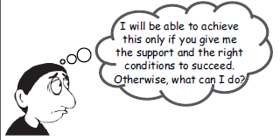
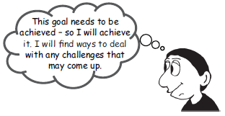
NON CONTRIBUTOR
CONTRIBUTOR

Slide 5
Where does power to contribute come from ? It comes from within the ourselves-from our commitment to be a contributor , practice contribution and to experience its fruits in our own lives . This commitment manifest itself as a gigantic will to contribute.
-Swami Vivekananda

Slide 6
FUNDAMENTAL “ BUILDING BLOCKS” FOR BECOMING A CONTRIBUTOR
A Shift from a “Victim” to being a “creator of one’s destiny”
Being acceptance from the ideal contributor ship
Being a willingness to take full responsibility for one’s own department
Being the capacity to reflect on one’s development and make appropriate modification

Slide 7
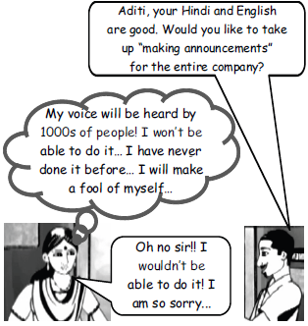
Example of embarking on the journey to contribution
Aditi was a clerk in a large company. One day , a senior approached her and offered her a new role…

Slide 8
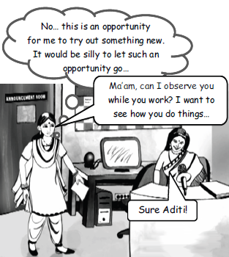
But Aditi continued to worry over it for days…

Slide 9
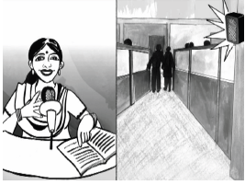
3 weeks later , Aditi accepted the offer and began making announcement….First doing just a few under the guidance of her senior…then some more…then independently . Her voice went out to 1000s of employees..

Slide 10
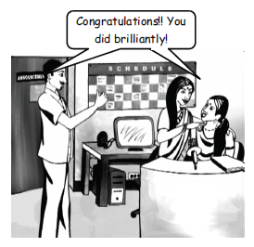
She did such a great job ! People from all over the company praised her…

Slide 11
SUMMARY
Non-Contributors constantly blame others. Contributors recognize that they are responsible for their own problems, and so they solve these problems.
The Contributor’s image of self is not built on the pride of “knowledge gained”. Rather, he/she oneself as a “learner” – where he/she is always willing to learn and grow.

Slide 12
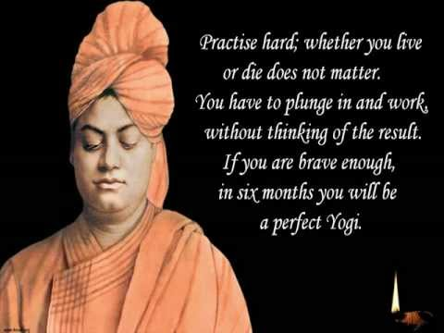

Slide 13
THANK YOU…

