Slide 1
FOCUS OF VALUE

Slide 2
- Contributor -
The aspect of contributor’s mindset is his goal of creating value for – self, family, team, organization,customer,and society.
Creating value means making,
A positive diffrence
A tangible impact
A specific Contribution to any situation

Slide 3
The positive difference or impact can be in the form of achieving ;
a specific goal
Creating a product
Creating “human touch” in a particular interaction
Enhancing one’s own capacity or the capacity of one’s colleagues and team-mates.

Slide 4
How Contributor have demonstrated a “focus on human value” in their work and the work practices they followed :
I try to understand this concept to take an 3 example of contributor who I believe have created a lot of value in his professional life :
Dr. A.P.J.Abdul Kalam (scientist & 11th President of India)
Anna Hajare (follower of Mahatma Gandhi)
Role of anil kapoor in “NAYAK” movie.

Slide 5
Dr. A. P. J. Abdul Kalam
(15 October 1931)
Dr. A. P. J. Abdul Kalam, is an Indian scientist and administrator who served as the 11th President of India.
Kalam was born and raised in Rameswaram, Tamil Nadu.
Before his term as President, He initially worked in DRDO in 1958 and then joined ISRO in 1963.

Slide 6
As project Director, SLV-III, India's first indigenous Satellite Launch Vehicle, he helped inject Rohini satellite in the near earth orbit.
He planned a program that produced a number of successful missiles, helping him earn the nickname "Missile Man”.
Kalam sought the ways of science and technology to transform India into a developed country. He is considered a leading progressive, mentor, innovator and visionary in India.
In 2002 Kalam easily won the elections in and continued up to 2007.
His book "India 2020" strongly advocates an action plan to develop India into a knowledge superpower and into a developed nation by the year 2020.

Slide 7
AWARD WINNING BY DR.KALAM
Ramanujan Award by Alwars Research Centre, Chennai (2000)
Padma Vibhushan (1990)
Veer Savarkar Award (1998)
Bharat Ratna (1997)
Indira Gandhi Award for National Integration (1997)
Prof Y Nayudamma Memorial Gold Medal (1996)
GM Modi Award for Science (1996)

Slide 8
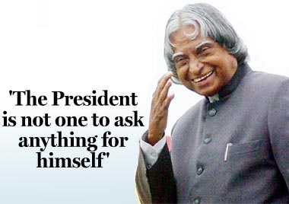
GOOD QUALITIES IN DR.KALAM LIFE
strict personal discipline
practicing vegetarianism
written several inspirational books
his autobiography Wings of Fire
aimed at motivating Indian youth.

Slide 9
ANNA HAJARE
Anna Hajare, is an Indian social activist with Indian anti-corruption movement who followed by Mahatma Gandhi.
He was born in Bhingar village in Ahmednagar district of Maharashtra state.
Anna Hazare – Story of Army Driver becoming the Father of Nation Bigger than Bharat Ratna .
(15 January 1940)

Slide 10
Anna had enrolled with the Army on April 14, 1963.
Anna Hazare started his career as a driver in the Indian Army.
During his 15-year tenure as a soldier, When Anna was in Army five medals were notified to Anna – 1. Sainya Seva Medal, 2. Nine Years Long Service Medal, 3. Sangram Medal, 4. 25th Independent Anniversary Medal 5. Paschimi Star
Hazare visited the project and decided to implement it in Ralegan Siddhi.
He steered the villagers to begin working towards water conservation.
At the outset, they completed 48 Nala Bunding work, contour trenches, staggered trenches, gully plugs, meadows development and of forestation of 500 hectares of land.

Slide 11
He started a new venture in 1991 called Bhrashtachar Virodhi Jan Aandolan (BVJA) or public movement against corruption.
It was found that some 42 forest officers.
After this Anna started to fight for the “Right to information act”. Government ignored Anna. In 1997 Anna agitated in Azad Maidan in Mumbai to create mass public awareness about RTI amongst the youth.Anna started to travel across state.
After 12 days of Hunger strike in Azad Maidan the President of India signed the draft of the Right to Information Act and ordered the state government to implement it with effect from 2002.
On April 5 2011 Again Anna started second freedom struggle in India.

Slide 12
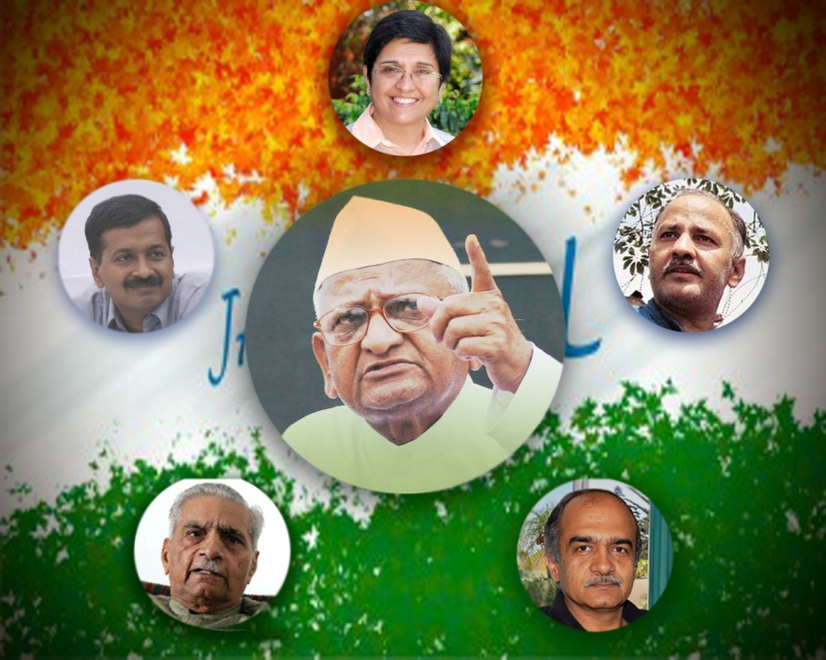
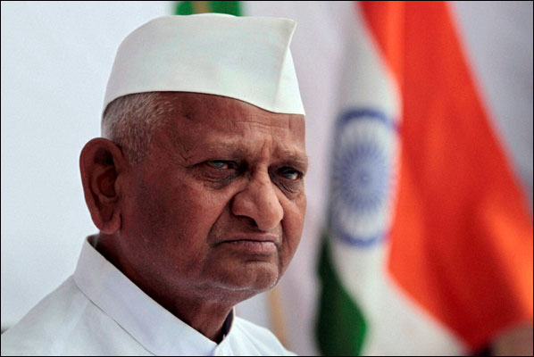
Anna wrote to everyone regarding Jan Lok Pal bill but no one listened him.
After that on 5th April 2011 Started fast unto death to wake up the government for India.
Hazare has started a fast unto death from 5 April 2011 at Jantar Mantar in Delhi FOR Jan Lokpal Bill.

Slide 13
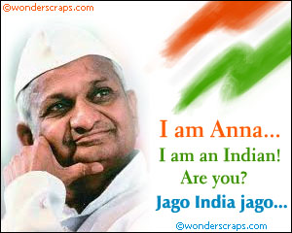
AWARD WINNING BY ANNA HAJARE
Indira Priyadarshini Vrikshamitra Award (1986)
Padmashri Award (1990)
Padmabhushan Award (1992)
Jit Gill Memorial Award (2008)

Slide 14
ROLE OF ANIL KAPOOR IN “NAYAK”
We focuses on the role of Shivaji Rao (Anil Kapoor). He happens to be an ambitious TV cameraman working for “Q TV”. And Chief Minister Balraj Chauhan (Amrish Puri) in this picture.
Chauhan later agrees to a live interview with Shivaji, during the course of which Rao raises these issues and airs the Chief Minister's stand he had caught on tape.
`

Slide 15
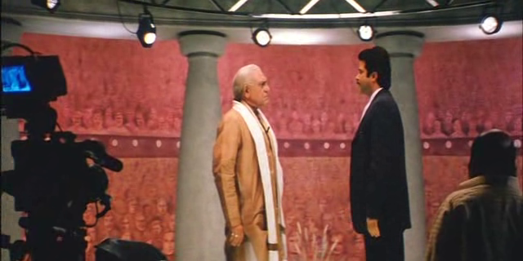
Movie Scenes
Chauhan redirects the question by instead talking about how difficult his job is due to red tape, and challenges Shivaji to be the CM for a day and experience those problems himself.

Slide 16
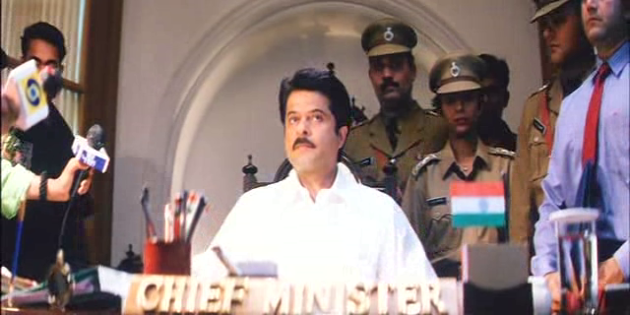
Shivaji reluctantly accepts the challenge to prove Chuhan wrong. Educated Shivaji takes care of issues that affect the population everyday.
However, Bansal shows up and tells him that Shivaji's popularity has rocketed sky-high and people want him to become the next CM of the state

Slide 17
THANK YOU

