Slide 1
Atmiya institute for diploma studies
SWAMI VIVEKANAND CONTRIBUTOR’S PERSONALITY DEVELOPMENT PROGRAME PROJECT- “VISSION OF SUCCESS”
DESIGNED BY :
DHAMSANIYA NENSI
NANDHA PRIYANKA TANK KHUSALI
VAGHERA NAMRATA
PARMAR MITTAL

Slide 2
VISSION OF SUCCESS

Slide 3
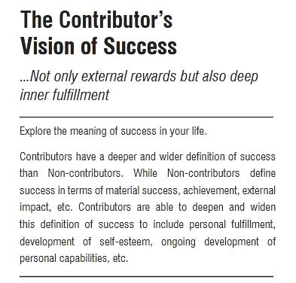

Slide 4
“ CONTRIBUTOR’S HAVE WORKS NOT ONLY EXTERNAL REWARDS BUT ALSO FOR DEEP INNER FULFILMENT.”
CONTRIBUTOR’S VISSION OF SUCCESS

Slide 5
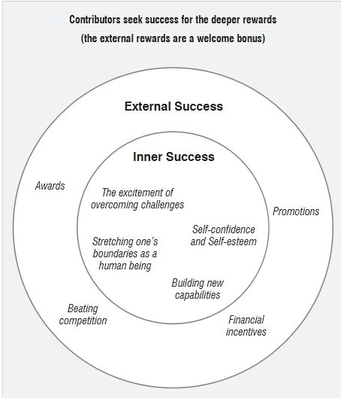

Slide 6
WE WATCH SOME MOVIE EXAMPLES, THEY ARE PROVE “CONTRIBUTOR’S VISION OF SUCCESS”

Slide 7
VISION OF SUCCESS MOVIE

Slide 8
FROM LAGAAN MOVIE WE LEARN THAT HOW TO ACHIEVE OUR SUCCESS ALTHOUGH THERE ARE MANY DIFFICULTIES.

Slide 9
VISSION OF SUCCESS MOVIE

Slide 10
PLAYERS IS THE MOVIE ABOUT SUCCESS WHRE THEY STOLE THE RUSSIAN GOLD FOR THE INDIAN POOR PEOPLE.
WHERE THEY GET MANY DIFFICULTIES FOR THE STOLEN THEN ALSO THEY GET SUCCESS.

Slide 11
ACHIVING THE GOAL

